Slide 1
Bank System Diagrams

Slide 2
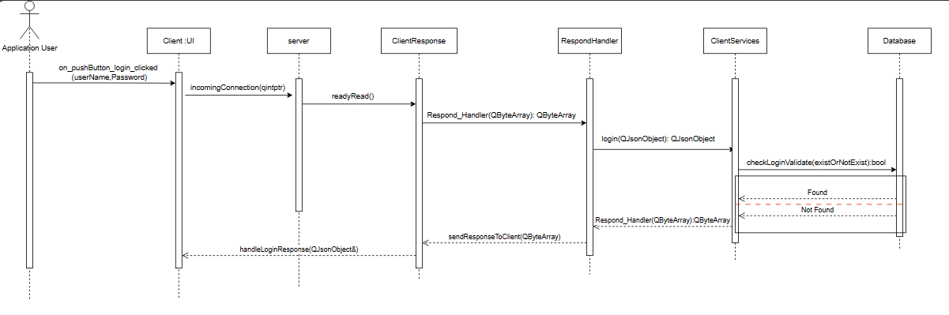
Sequence diagram

Slide 3
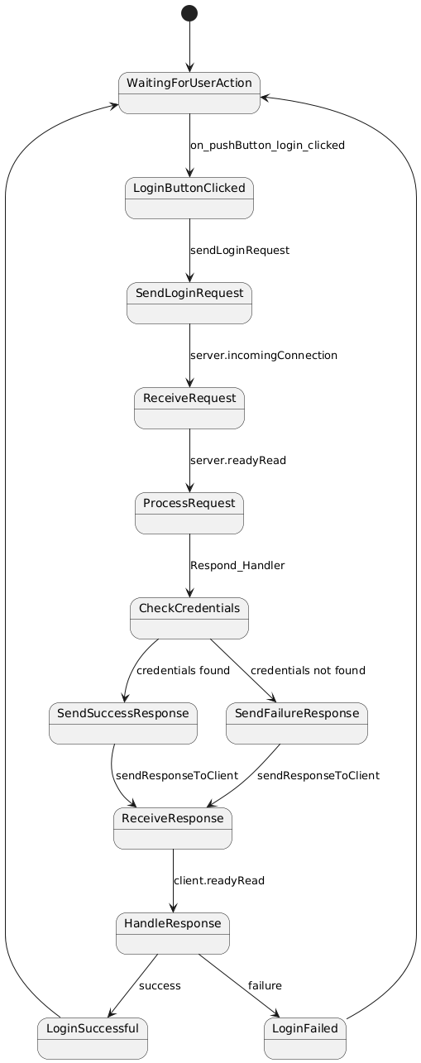
State diagram

